Slide 1
Lab 1 Mininet/ONOS Installation

Slide 2
Outline
Mininet
OpenDaylight
Add flow via REST API
Appendix
Reference

Slide 3
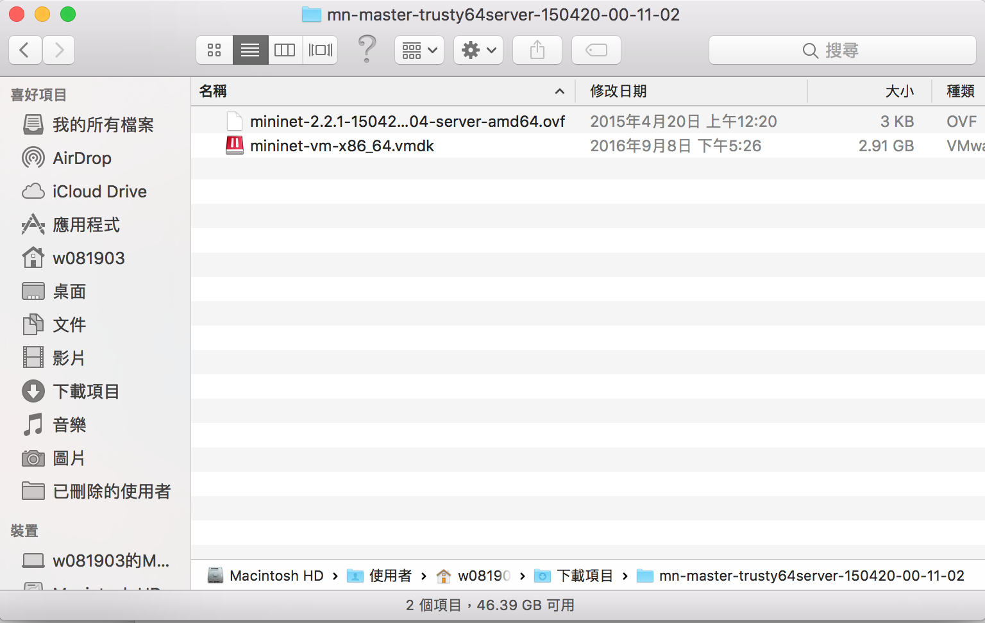
Mininet
Download virtual disk from https://github.com/mininet/mininet/wiki/Mininet-VM-Images

Slide 4
Mininet
Boot Mininet by Virtualbox, Vmware, Parallels Desktop

Slide 5
Virtualbox
Mininet image
Ubuntu
Interface 2
Interface 1
Internal Network
NAT
Internet

Slide 6
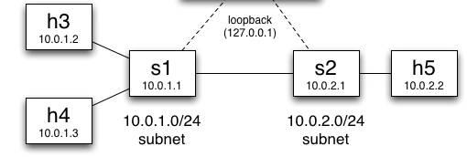
Virtualbox
Controller
Internal Network
NAT
Internet

Slide 7
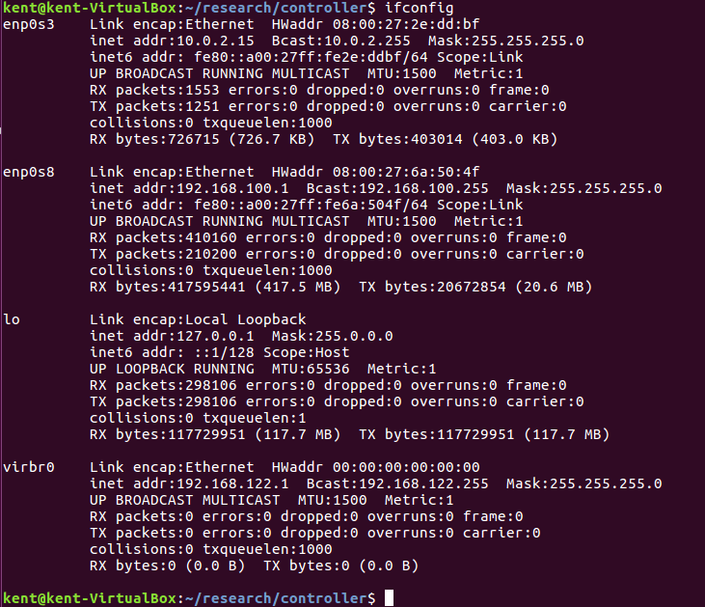
VirtualBox
Setup interfaces in Ubuntu
sudo dhclient enp0s3
sudo ifconfig enp0s8 192.168.100.1

Slide 8
VirtualBox
Setup interfaces in Mininet
sudo ifconfig eth0 192.168.100.2

Slide 9
Virtualbox
double-click on the .ovf file and import it
If you get errors importing the .ovf file, you can simply create a new VM of the appropriate type (e.g. Linux, Ubuntu 64-bit) and use the .vmdk file as the virtual hard disk for the new VM.
Select “settings,” and add an additional host-only network adapter that you can use log in to the VM image. Start the VM.

Slide 10
Vmware
Import the OVF file, then start the VM
VMware may ask you to install VMware tools on the VM - if it asks, decline

Slide 11
Parallels Desktop
Use Parallels Transporter to convert the .vmdk file to an .hdd image that Parallels can use, and then create a new VM using that .hdd image as its virtual drive. Start the VM.

Slide 12
Log in to VM
Account : mininet
Password : mininet

Slide 13
Log in via SSH
VMware : ssh -Y mininet@[mininet’s ip address]
Virtualbox : Users who have set up a host-only network on eth1 should use sudo dhclient eth1 and check it has an ip address
ssh -Y mininet@[mininet’s eth1 ip address]

Slide 14
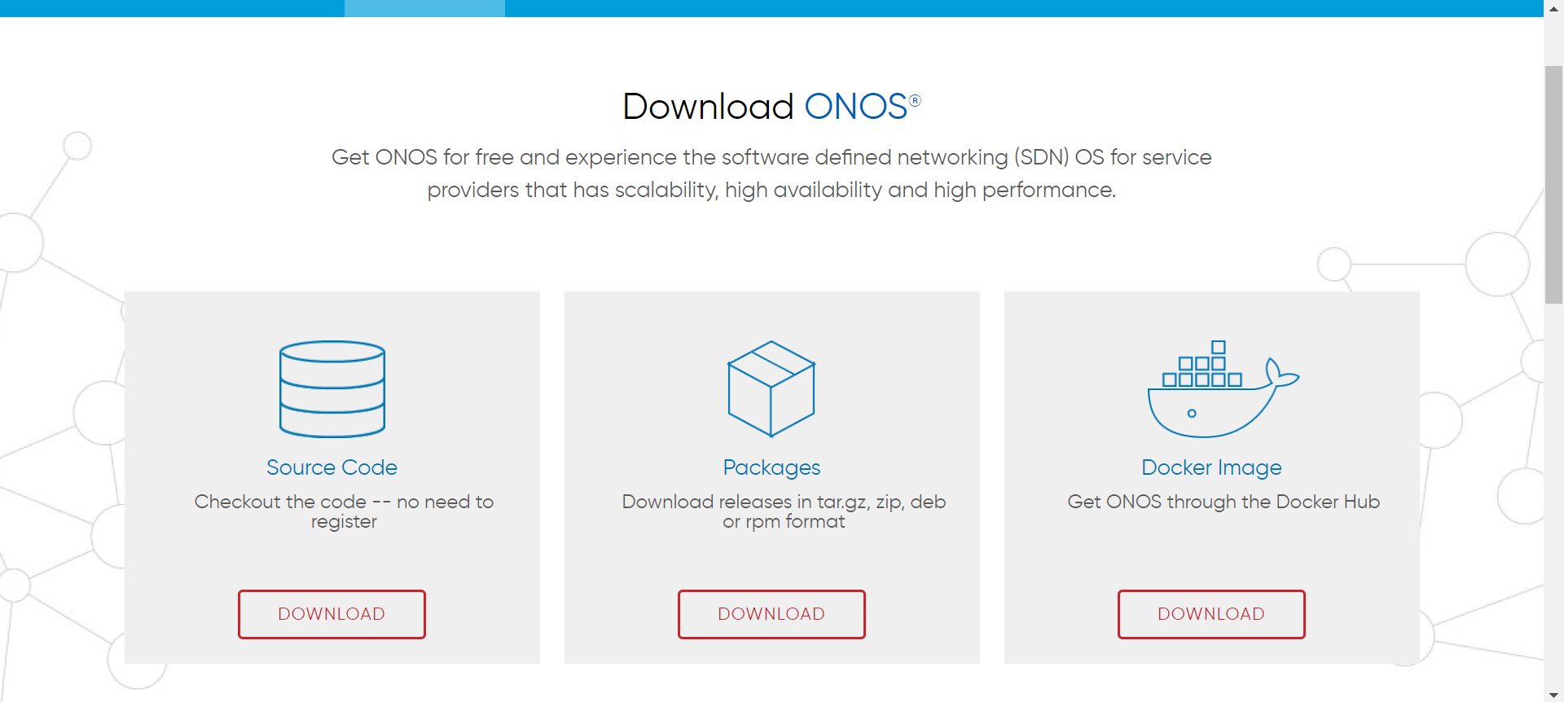
ONOS
Download ONOS package in the following website:
https://onosproject.org/software/

Slide 15
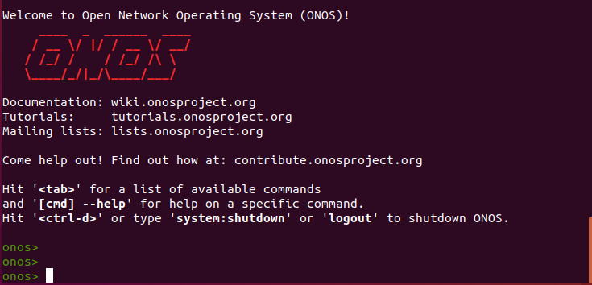
ONOS
Use cd command to ONOS folder
"./bin/onos-service start” to launch ONOS

Slide 16
Activate OpenFlow
onos> app activate org.onosproject.openflow
onos> app activate org.onosproject.openflow
Use "feature install [feature name]" to install feature
To activate OpenFlow
onos> app activate org.onosproject.openflow
Use feature:list -i to list all installed features
Check the following web site for more details:
http://www.stackguy.com/archives/248

Slide 17
launch mininet
sudo mn --mac --switch ovsk,protocols=OpenFlow13 —controller=remote,ip=[controller’s ip] --topo linear,2
sudo mn --mac --switch ovsk,protocols=OpenFlow13
--controller=remote,ip=192.168.100.1
--custom ./mininet/custom/test.py --topo mytopo
The default topo with two switches
The file to setup a topology

Slide 18
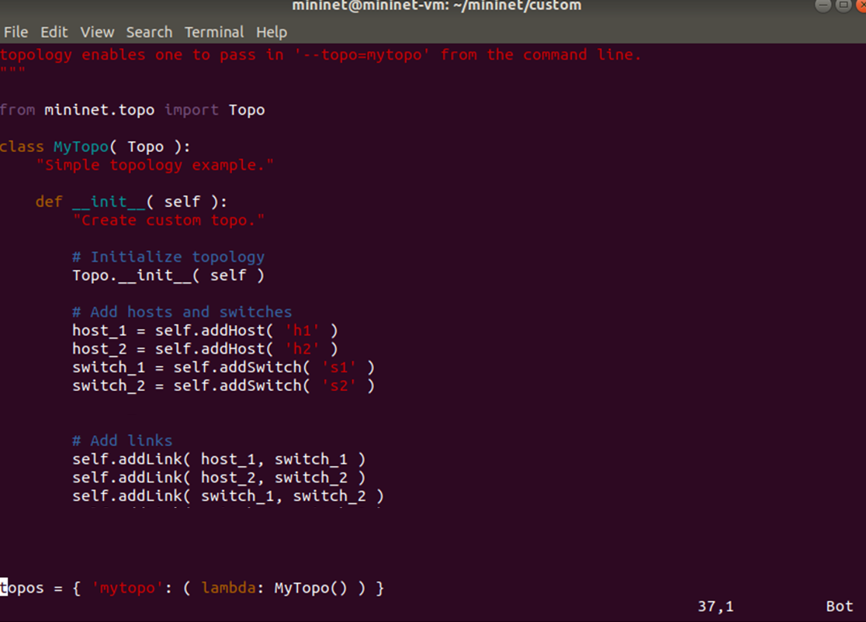
test.py

Slide 19



Topology

Slide 20
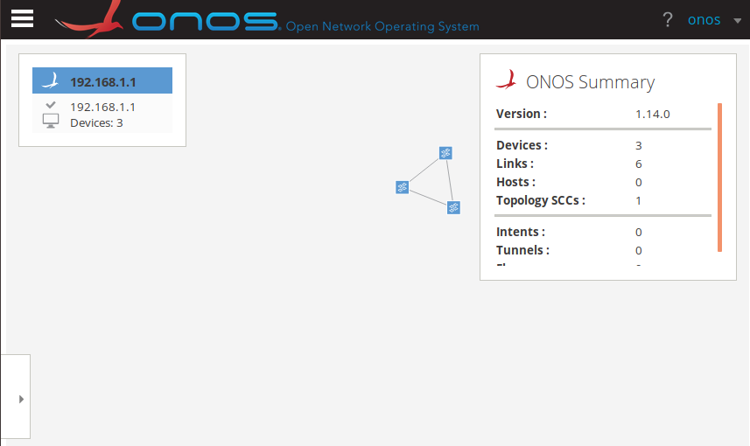
Topology via Web Page
http://localhost:8181/onos/ui/index.html
Login/password = onos/rocks

Slide 21
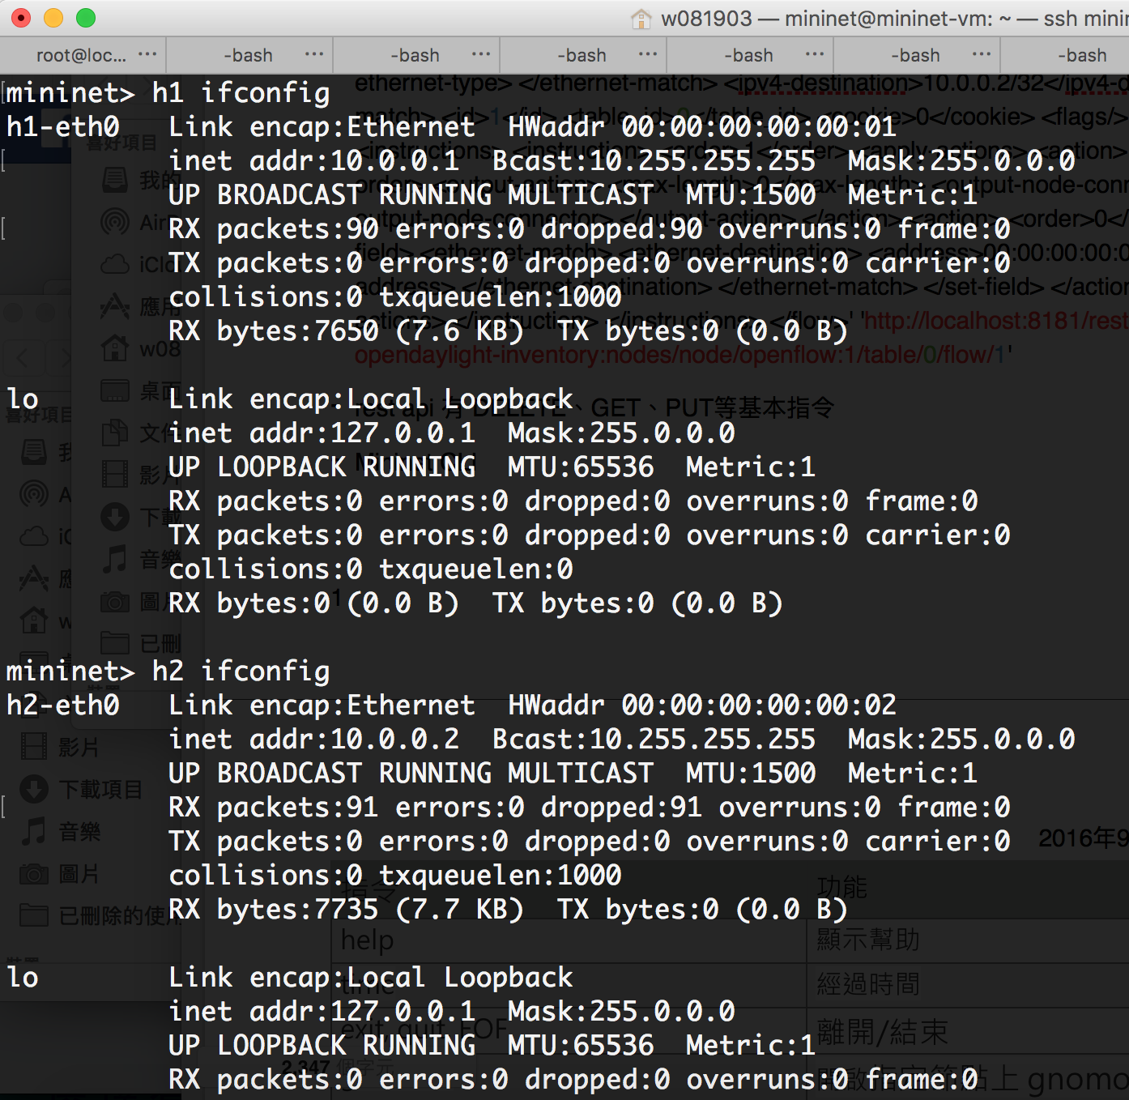
Mininet test
In mininet environment we can use h1 ifconfig to check what h1’s ip address it is.

Slide 22
Install flow to vSwitch
We can use Rest API to install flow from controller to vswitch
curl -X POST -H "content-type:application/json" http://localhost:8181/onos/v1/flows/of:0000000000000001 -d @./test_1.json --user onos:rocks
Switch ID
Json file for the rule

Slide 23
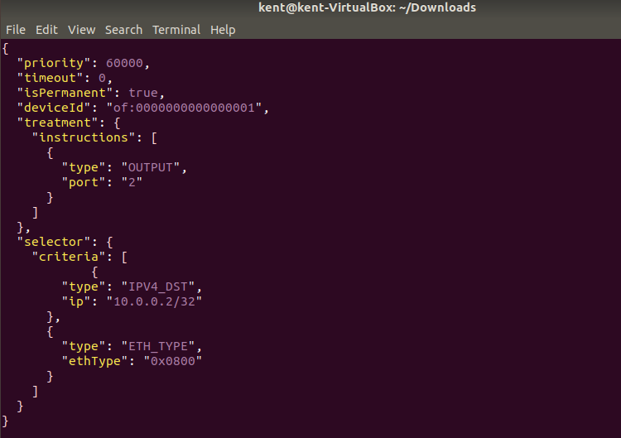
Install flow to vSwitch
Action (how to process the packet)
The packet we want to match

Slide 24
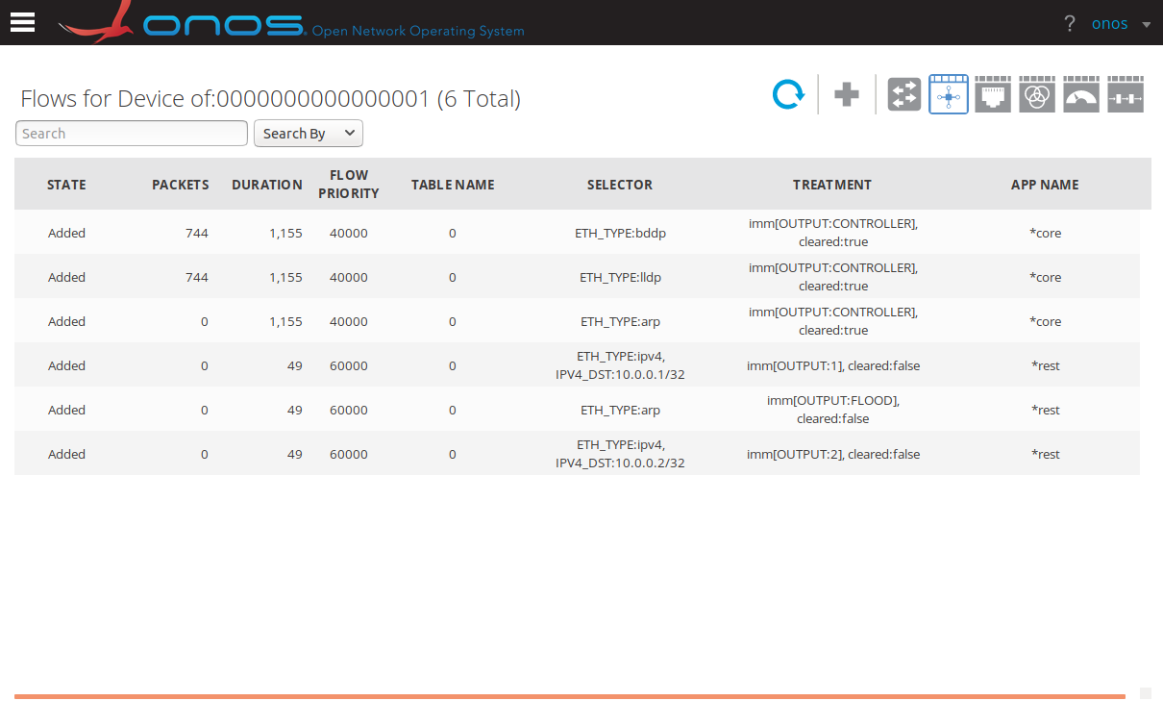
Check Flow
ONOS web site
The flow which we add

Slide 25
Test Traffic
Use iperf or ping
h1 ping h2
iperf

Slide 26
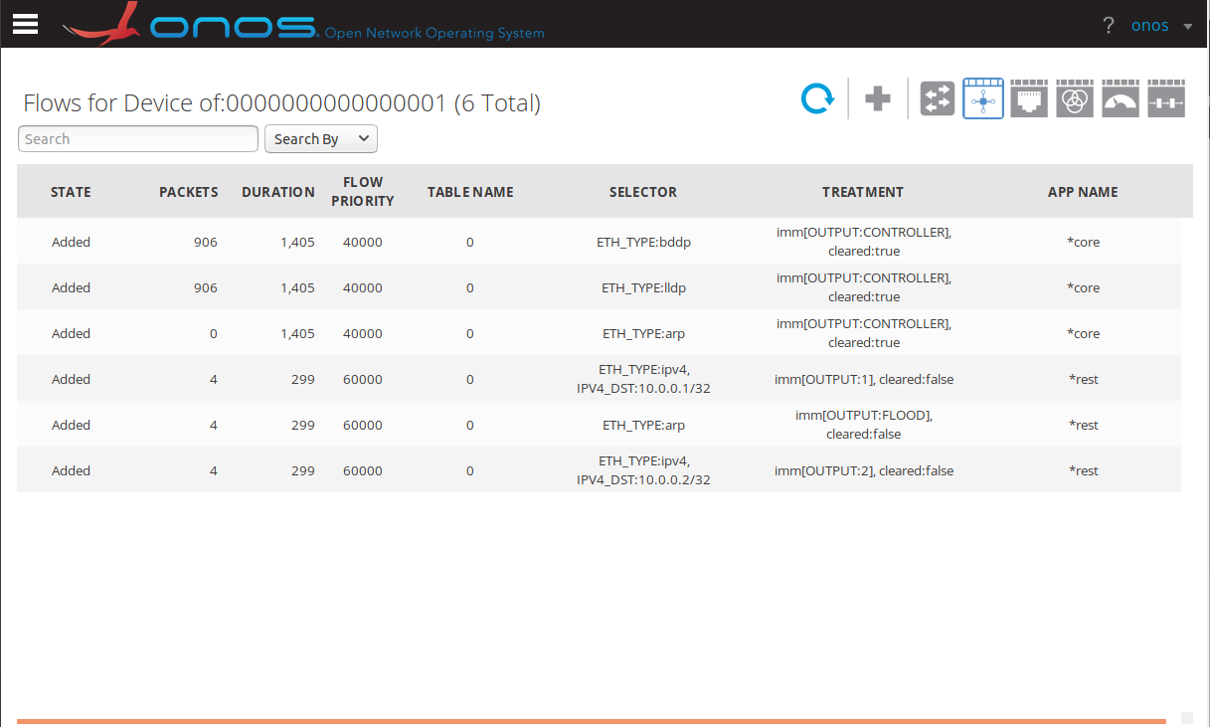
Check Flow
Use sh ovs-ofctl dump-flows -O OpenFlow13 s1
The number of packets matching the rules

Slide 27
Homework
h1 ping h2
產生有兩條路徑的topology
讓ping packet走較長的路徑
在NTU COOL上傳三張螢幕截圖:
Switch s3的forwarding table
Ping 成功的畫面
ONOS GUI中的topology
Due: 4/1, 2024

Slide 28
Topology

Slide 29
reference
ONOS and mininet
http://www.stackguy.com/archives/248
json for rule
https://wiki.onosproject.org/display/ONOS/Flow+Rules
curl to install rules
https://wiki.onosproject.org/display/ONOS/REST

